Slide 1
Scaling Expander Networks for Boolean Multiplication
Nathan Kodama & Laura Monroe
March 9, 2022

Slide 2
Motivation
Problem: scaling Boolean multiplication on Ising hardware.

Slide 3
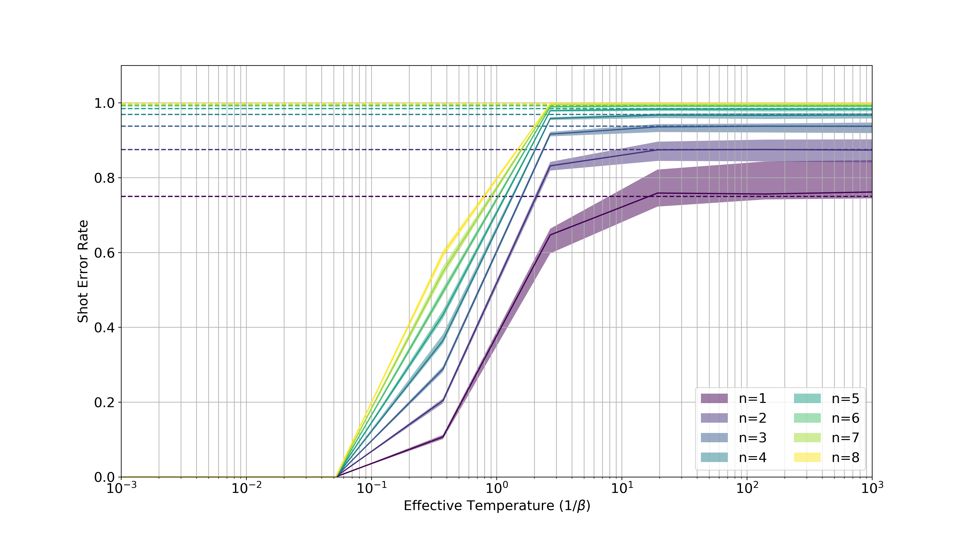
Addition: error rates for n bits as a function of temperature
Dashed Lines: Predicted (Maximum Entropy) Error Rates
Feasible Solution
Regime
Maximum Entropy
Regime

Slide 4
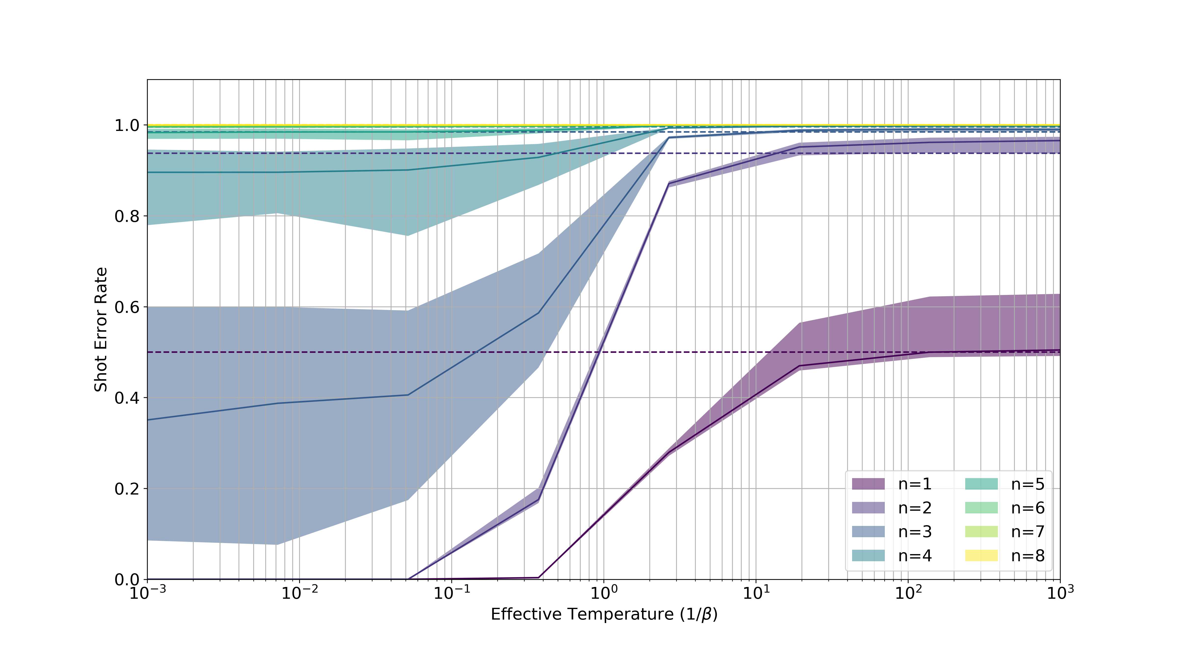
Multiplication: error rates for n bits as a function of temperature
Dashed Lines: Predicted (Maximum Entropy) Error Rates
No Scalable
Solution
Maximum Entropy
Regime

Slide 5
Motivation
Problem: scaling Boolean multiplication on Ising hardware.
Key Idea: replace computing with coding.

Slide 6
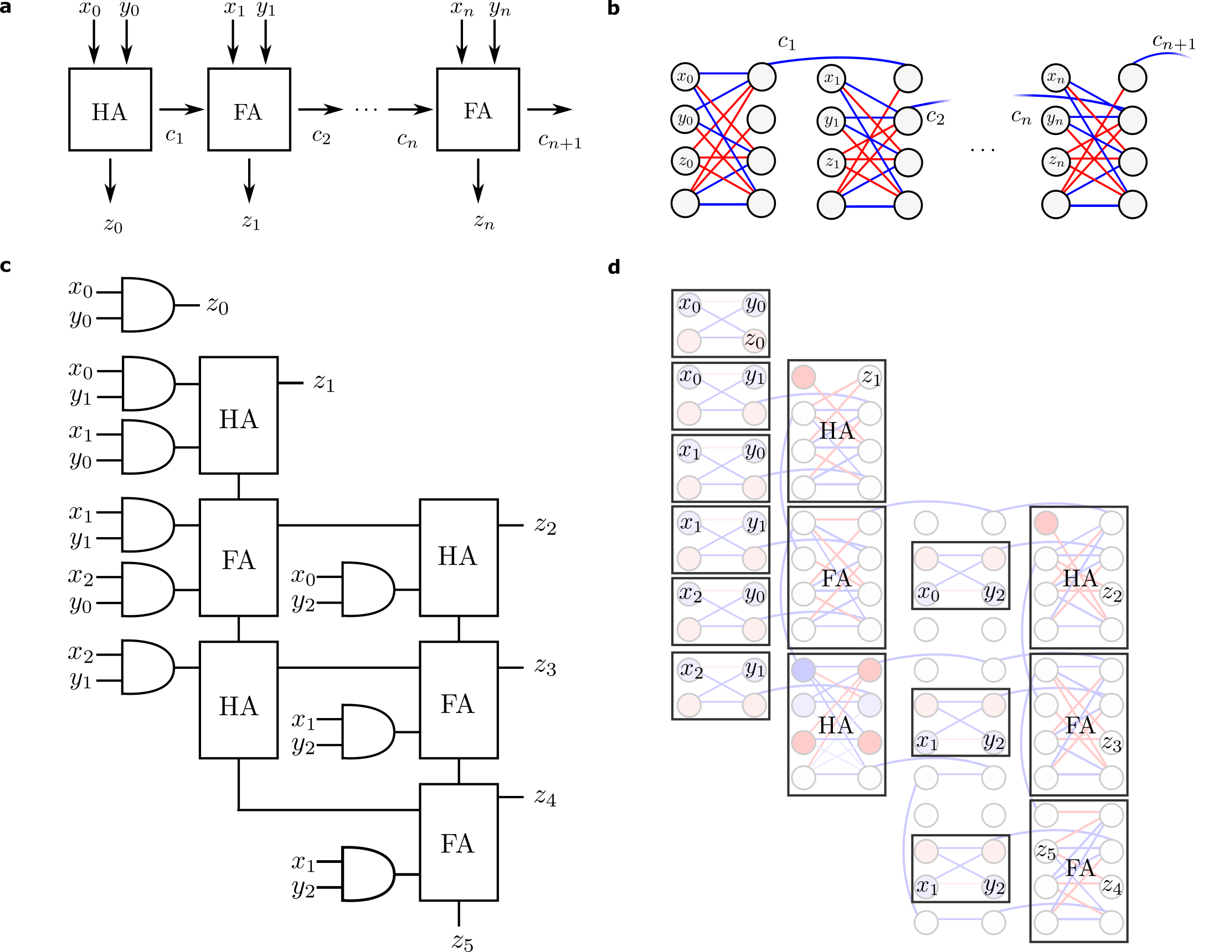
Naïve “computing” approach: locally model the constraints of circuits
Ripple-Carry
Adder
Baugh-Wooley
Multiplier

Slide 7
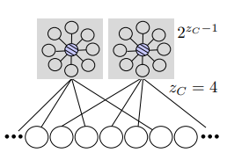
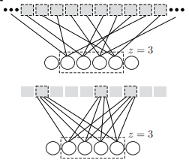
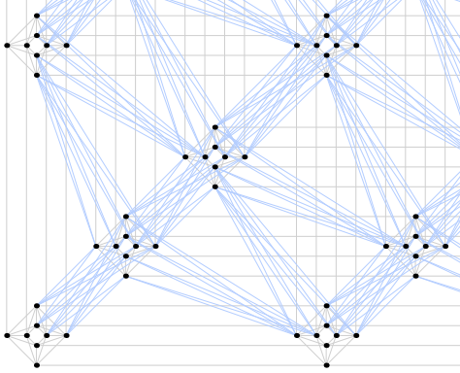
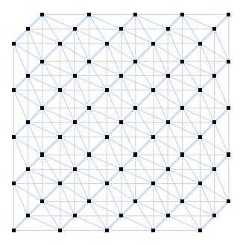
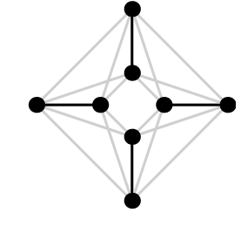
Our “coding” approach: non-locally model parity constraints
Sparse Expander Network
Parity Constraints
Hardware Embedding
P₅
P₃
P₇

Slide 8
Motivation
Problem: efficient scaling of Boolean multiplication on Ising hardware.
Key Idea: replace computing with coding.
Why might it work?

Slide 9
Why might it work?
Given theoretical guarantees for expander networks¹ (see definitions in Appendix A):
Robustness
Exponential capacity
Non-vanishing information rate
¹Chaudhuri & Fiete (2019)

Slide 10
Multiplication has 2^{2n} valid states of 2^{4n} possible states.
Multiplication has a non-vanishing information rate: log(2^{2n})/log(2^{4n}) = 1/2.
Expander networks have the capacity to model multiplication.
At what cost?
Example: Truth Table for 2-bit Multiplication
n = 2
Input A |  | Input B |  | Output
a₁ | a₀ | b₁ | b₀ | p₃ | p₂ | p₁ | p₀
0 | 0 | 0 | 0 | 0 | 0 | 0 | 0
0 | 0 | 0 | 1 | 0 | 0 | 0 | 0
… | … | … | … | … | … | … | …
1 | 1 | 1 | 1 | 1 | 0 | 0 | 1
2^{2n} = 16

Slide 11
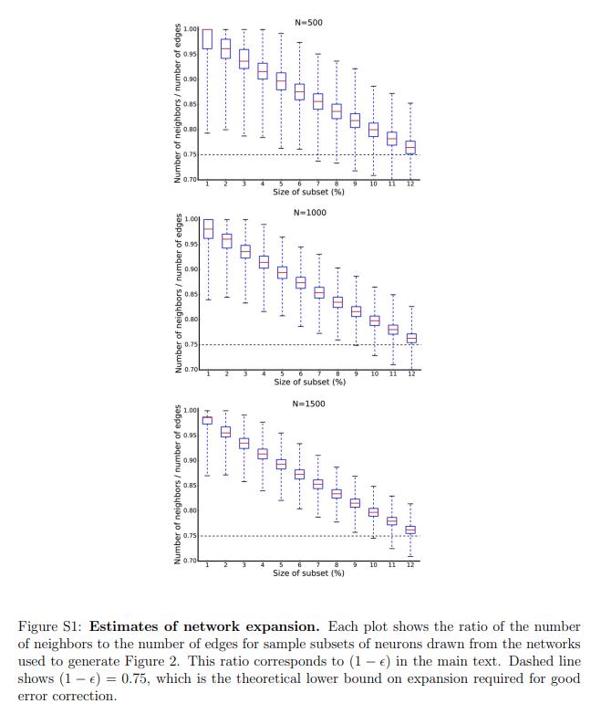
*Scaling Expander Networks
Scale invariance of expansion implies linear computational complexity (see derivation in Appendix A).
Compared to quadratic scaling of the naïve “computing” approach, we predict a computational advantage for ≥ 32-bit multiplication.
500 Neurons
1000 Neurons
1500 Neurons
Expansion
Size of Subset (%)
Size of Subset (%)
Size of Subset (%)
*Our key insight

Slide 12
Experimental Strategy
Verifying composability of parity checks.
Encoding Boolean multiplication with expander networks.
Demonstrating computational advantage.
Scaling expander networks to 32-bit transition.
P₅
P₃
P₇

Slide 13
Appendix A
Scale-invariant properties of sparse expander networks

Slide 14
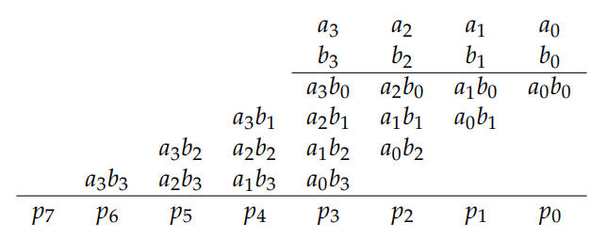
Boolean multiplication
For the multiplication of two n-bit integers, there are 2^{2n} valid states out of 2^{4n} possible states.
Multiplication of two 4-bit integers (a₃,a₂,a₁,a₀) and (b₃,b₂,b₁ ,b₀) to form the 8-bit product (p₇,p₆,p₅,p₄,p₃,p₂,p₁,p₀)

Slide 15
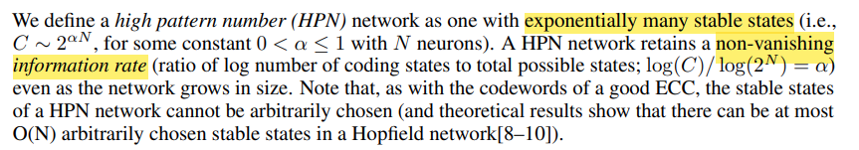
Encoding Boolean multiplication
We require a computational model with exponential-capacity and non-vanishing information rate.
Bipartite expander networks (BEN)
Chaudhuri & Fiete (2019)

Slide 16
Bipartite expander networks
N: number of visible nodes
z: degree of visible nodes
N_{c}: number of constraint nodes
z_{c}: degree of constraint nodes
Total number of edges is conserved:
Nz = N_{c}z_{c}
Good expansion (ε→0)
Bad expansion
Goal: Design N, z, N_{c}, and z_{c} o have the required capacity and “robustness.”
Chaudhuri & Fiete (2019)

Slide 17
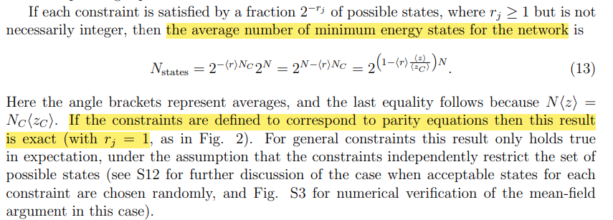

Deriving a capacity constraint
$$≥2^{2n}$$
Chaudhuri & Fiete (2019)

Slide 18
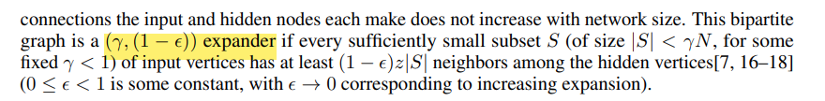



Deriving a robustness constraint
For Boolean multiplication, the minimum number of bits that we want to recover is 2n.
We use the robustness guarantee of a BEN to ensure that we can recover these bits.
$$≥2n$$
(1)
(2)
Chaudhuri & Fiete (2019)

Slide 19
Scale-invariant properties of BEN
Infer a linear relationship, (1- ε) = -mγ+b, invariant to network size
From the plots above, m ≈ 2 and b ≈ 1→ ε = 2γ
Substituting into (2), we obtain β = γ - 4γ²
An inverse parabola with a maximum at γ = 1/8, β = 1/16
Plugging in this solution into (1), the robustness constraint implies a lower bound that is linear in n, N ≥ 32n.
1-ε
γ
γ
γ
Chaudhuri & Fiete (2019)

Slide 20
Scaling of Naïve vs. Expander Coding
n | I/O sites | # Visible Sites (Naïve) - O(n²) | # Visible Sites (Expander Code) - O(n)
3 | 12 | 15 | 96
4 | 16 | 24 | 128
8 | 32 | 80 | 256
16 | 64 | 288 | 512
32 | 128 | 1088 | 1024
64 | 256 | 4224 | 2048
128 | 512 | 16640 | 4096
Dashed Line (Transition): Computational advantage for ≥ 32-bit multiplication

